Slide 1
Exploratory Data Analysis

Slide 2
Creatinine
Q-Q Plot
Histogram
No stratification
No stratification
12
1000
750
8
Sample
Count
500
4
250
0
0
-2
0
2
0
5
10
Theoretical
Creatinine

Slide 3
Creatinine
Measure | Value
Mean | 1.40442906574394
Median | 0.97
Mode | 0.76
Range | 0.1 - 12.08
IQR | 0.77
Missing # | 0

Slide 4
Inr
Q-Q Plot
Histogram
No stratification
No stratification
8
600
6
400
4
Sample
Count
2
200
0
0
-2
0
2
0.0
2.5
5.0
7.5
Theoretical
Inr

Slide 5
Inr
Measure | Value
Mean | 1.92076124567474
Median | 1.6
Mode | 1.3
Range | 0.9 - 8.6
IQR | 1.1
Missing # | 0

Slide 6
Sodium
Q-Q Plot
Histogram
No stratification
No stratification
170
160
600
150
Sample
Count
400
140
130
200
120
0
-2
0
2
120
130
140
150
160
170
Theoretical
Sodium

Slide 7
Sodium
Measure | Value
Mean | 135.96401384083
Median | 137
Mode | 137
Range | 119 - 170
IQR | 5
Missing # | 0

Slide 8
Num_rnd1
Q-Q Plot
Histogram
No stratification
No stratification
15
150
10
100
Sample
Count
5
50
0
-5
0
-2
0
2
0.0
2.5
5.0
7.5
10.0
Theoretical
Num Rnd1

Slide 9
Num_rnd1
Measure | Value
Mean | 5.38754325259516
Median | 5.3
Mode | 3.2
Range | 1 - 10
IQR | 4.4
Missing # | 0

Slide 10
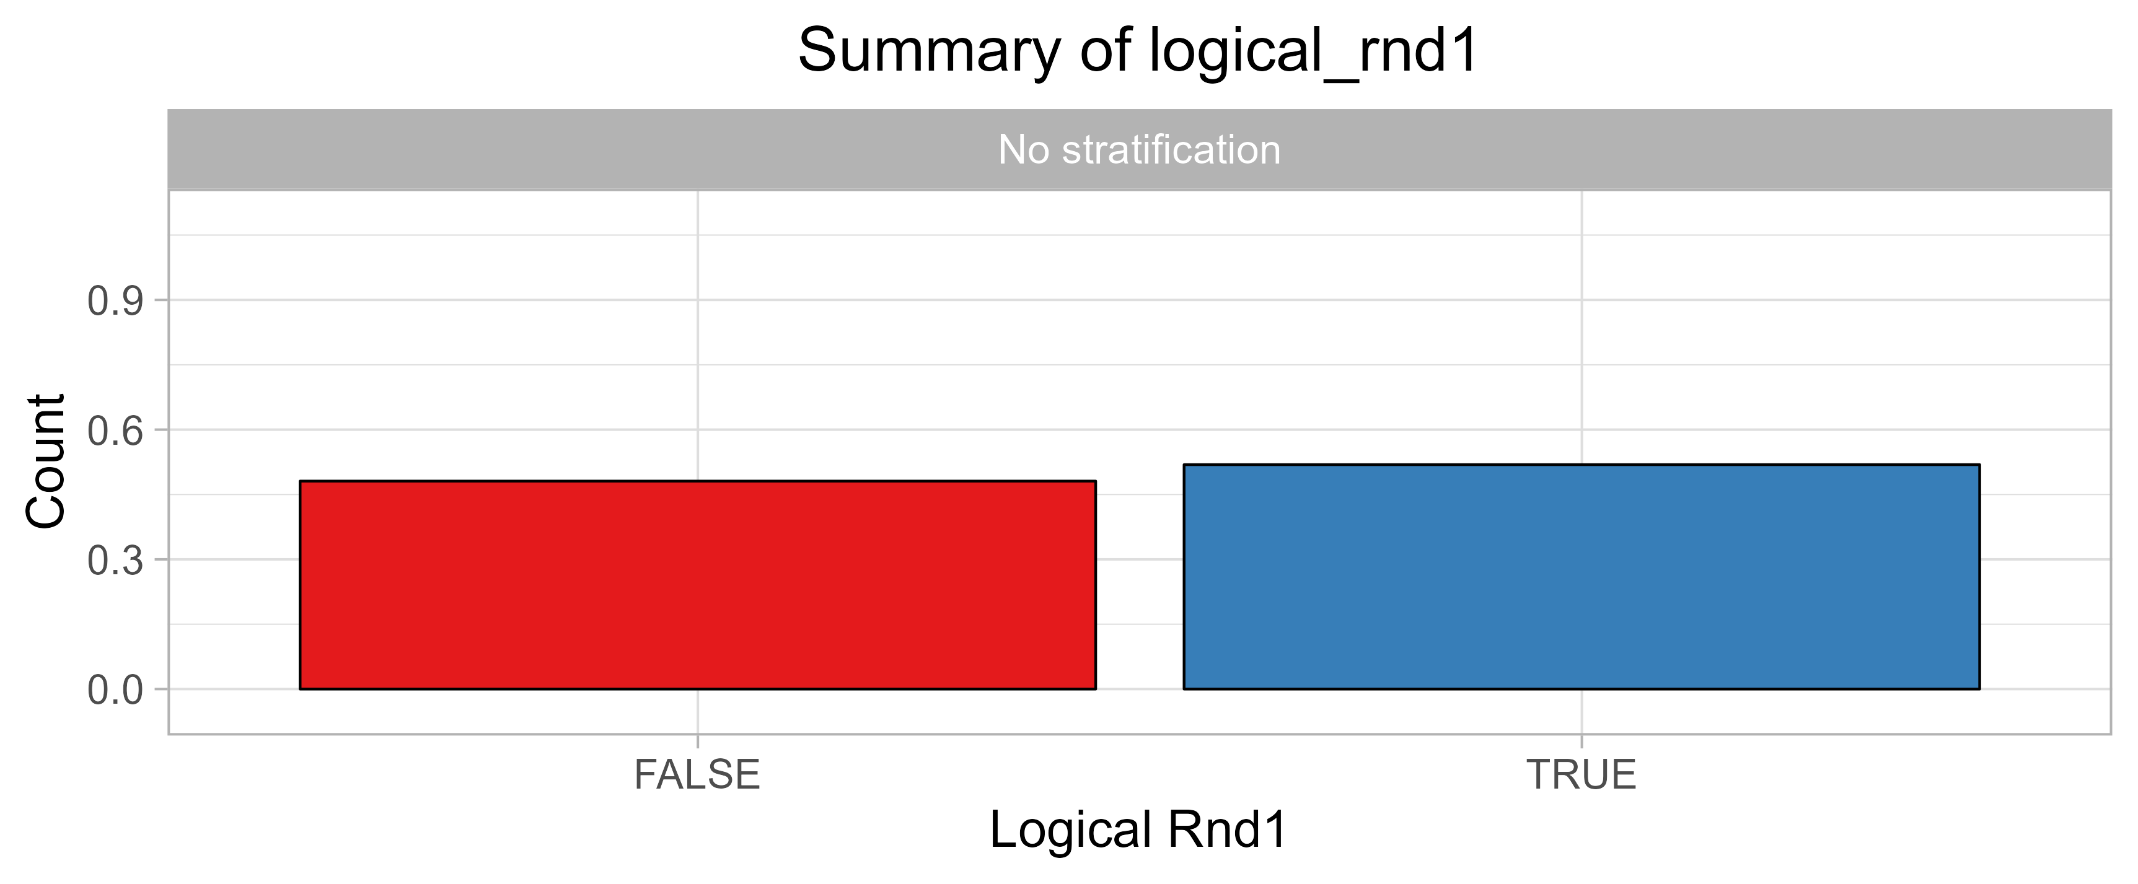
Logical_rnd1

Slide 11
Logical_rnd1
Measure | Value
Categories | FALSE TRUE
Missing # | 0

Slide 12
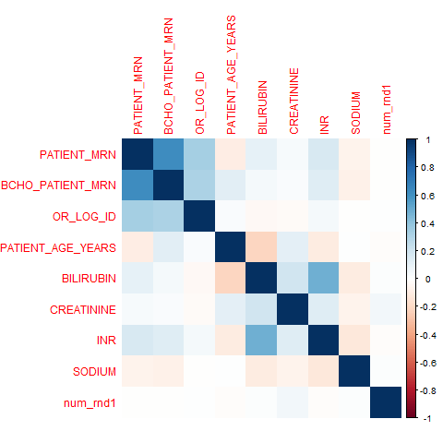
Correlation Matrix

